Slide 1
IC Voltage Regulators
A voltage regulator is an integrated circuit (IC) that provides a constant ﬁxed output voltage regardless of a change in the load or input voltage.
A regulated voltage (without ﬂuctuations & noise levels) is very important for the smooth functioning of many digital electronic devices.
Types of IC Voltage Regulators
Fixed positive voltage regulator
Fixed negative voltage regulator
Adjustable voltage regulator
Dual-tracking voltage regulator

Slide 2
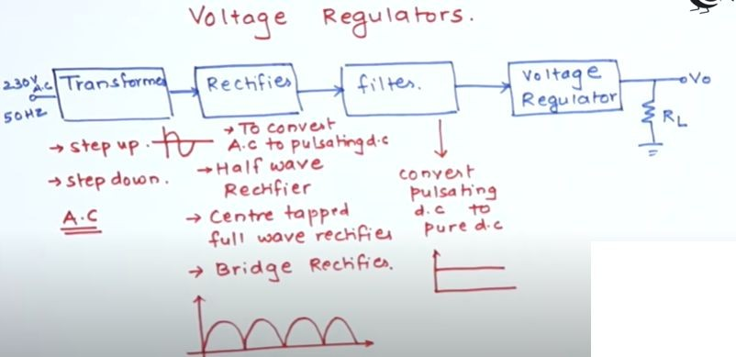

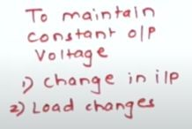
Concept of Voltage Regulators

Slide 3
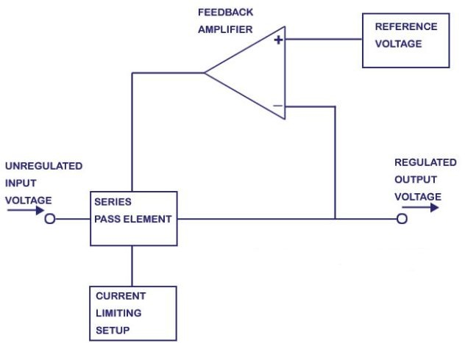
Block Diagram

Slide 4
A part of output voltage is taken with the help of potential divider formed by R1 and R2.
This is compared with reference voltage, Vref internally generated with the help of zener diode.
After comparison, a control signal is generated which is applied through protective circuit to the series pass transistor working as control element.
The control signal adjusts the control element in such a way that output voltage remains constant Thermal shutdown means that the chip will automatically turn itself oﬀ if the internal temperature exceeds, typically, 175°C
The current limiting circuit will protect the chip from excessive load current.

Slide 5
IC 723 Voltage Regulator
The IC 723 is a general purpose, extremely versatile voltage regulator IC, which can be used for making various types of regulated power supplies such as:
Positive Voltage Regulator
Negative Voltage Regulator
Switching Regulator
Features
The minimum voltage that can be achieved from IC 723 Regulator Circuit is 2 V, and the maximum is around 37 V.
The peak voltage that can handled by the IC is 50 V in pulsed form, and 40 V is the maximum continuous voltage limit.

Slide 6
The maximum output current from this IC is 150 mA which can be upgraded to as high as10 amps through an external series pass transistor integration.
The maximum tolerable dissipation of this IC 500 mW, therefore it should be mounted on a suitable heat sink in order to allow optimal performance from the device.
Being a linear regulator, the IC 723 needs an input supply that should be at least 3 V higher than the desired output voltage, and the maximum diﬀerence between the input and the output voltage should never be allowed to exceed 37 V.

Slide 7
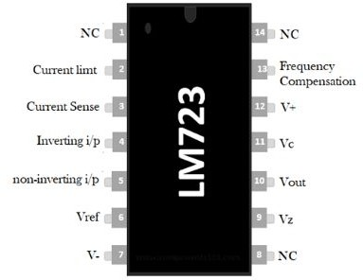
LM723 Pin Configuration
Pin1 (NC): Not connected
Pin2 (Current Limit): This pin is used to limit the current
Pin3 (Current Sense): This pin is used in foldback application as well as to limit the current
Pin4 (Inverting Input): This pin provides stable o/p voltage

Slide 8
Pin5 (Non-inverting Input): Supply a reference voltage to the inside of the operational ampliﬁer.
Pin6 (Vref): This pin provides an almost 7v reference voltage
Pin7 (-Vcc): GND (Ground) Pin
Pin8 (NC): Not connected
Pin9 (Vz): This pin is generally used to make negative regulators
Pin10 (Vout): This is the o/p pin
Pin11 (Vc): This is the series pass transistor’s collector input. Generally, it is connected directly to the +ve voltage supply if an exterior transistor is not used.
Pin 12 (V+): This is the input of the positive supply

Slide 9
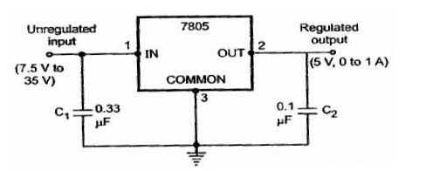
Fixed Voltage Regulators
A ﬁxed voltage regulator produces a ﬁxed DC output voltage, which is either positive or negative.
Examples
7805 voltage regulator IC produces a DC voltage of +5 volts.
7905 voltage regulator IC produces a DC voltage of -5 volts.
IC 7805 Regulator

Slide 10
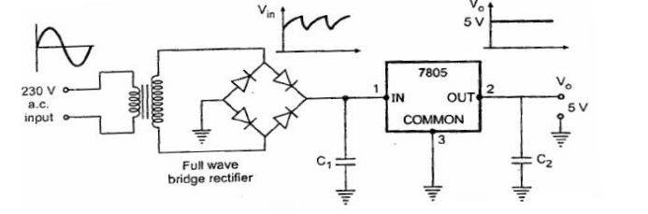
The maximum input voltage which can be applied to IC 7805 is 35 V.
The maximum dropout voltage is 2.5V. The output of 7805 regulator is 5 V ﬁxed.
Hence minimum input voltage required is 5 +
2.5 = 7.5. So input range of IC 7805 regulator is
7.5 Vto35 V to get ﬁxed 5V as regulated output.
Positive 5 V Power Supply using IC 7805

Slide 11
A 5V output voltage supply system using full wave bridge rectiﬁer, capacitor ﬁlter and IC regulator 7805 .
The a.c. line voltage is 230 V which is stepped down to 15 V using a transformer.
A full wave rectiﬁer along with the capacitor voltage provides the unregulated voltage input to IC 7805 regulator.
This input contains ac ripple of few volts. The IC 7805 regulator provides the regulated output of 5V.

Slide 12
Limitations of Linear Voltage Regulators
The regulators discussed up till now are called as linear regulators because the series pass transistor used in such regulators operates in the linear region.
Linear regulated power supplies have following limitations:
The required input step down transformer is bulky and expensive.
Due to low line frequency (50 Hz), large values of ﬁlter capacitors are required.
The eﬃciency is very low.
Input must be greater than the output voltage.
As large is the diﬀerence between input and output voltage, more is the power dissipation in the series pass transistor.

Slide 13
Precision Rectifier
A precision rectifier differs from ordinary diode rectifier.
If a ordinary diode is used, the cut in voltage is 0.6V for silicon or 0.3V for germanium. So a input voltage greater than cut in voltage can only be rectified.
This drawback is eliminated in precision rectifier by placing a ordinary diode in feed back path of an OPAMP.
The actual cut in voltage of diode is divided by large open loop gain of OPAMP ( 10⁴). So the cut in Voltage restriction can be reduced substantially.
Even input signal in the range of milli -volts can be effectively rectified.

Slide 14
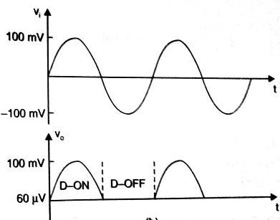
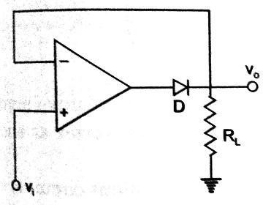
Precision Rectifier
^{0.6}/₁₀₄ = 60μ𝑉

Slide 15
Application Precision Diode
Half wave rectifier
Full wave rectifier
Peak value detector
Clipper
Clamper

Slide 16
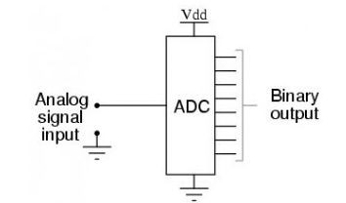
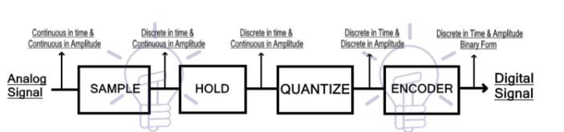
Analog to Digital Converters
A converter that is used to change the analog signal to digital is known as an analog to digital converter or ADC converter.
This converter is one kind of integrated circuit or IC that converts the signal directly from continuous form to discrete form.

Slide 17
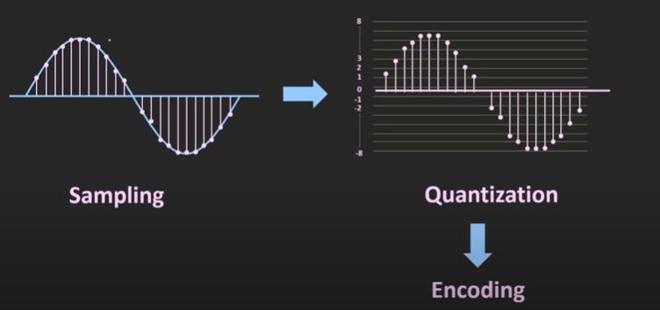

Slide 18
Types of ADC
Successive Approximation
Single Slope
Dual Slope
Flash type
Counter type
Continuous

Slide 19
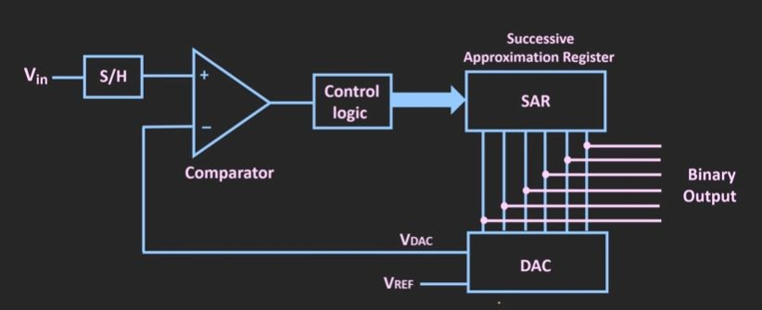
Successive Approximation

Slide 20
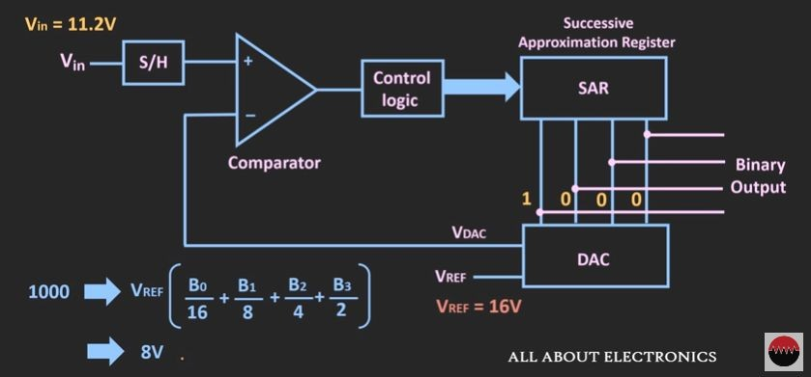
It consists of SAR, DAC, Comparator
If Vin > VDAC , Comparator output is High
Whenever circuit is ON, SAR ﬁx its MSB as 1

Slide 21
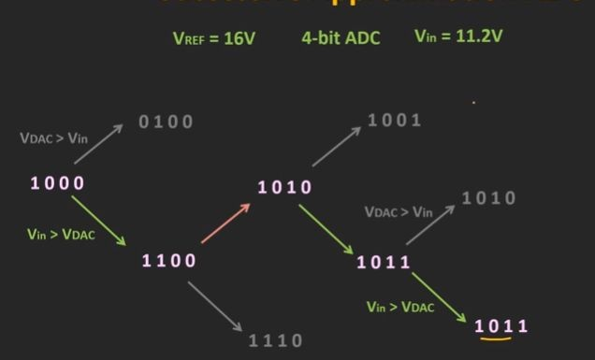
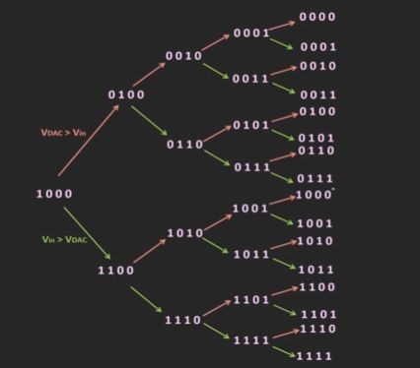

Slide 22
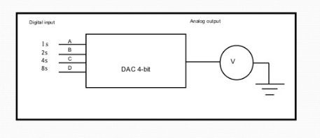
Digital to Analog Converters(DAC)
Digital to Analog Converter commonly referred as DAC, D/A or D2A is a device that converts binary values (0s and 1s) to a set of continuous analog voltages.

Slide 23
Types
Binary weighted Resistor
R-2R Ladder
Inverted R-2R Ladder

Slide 24
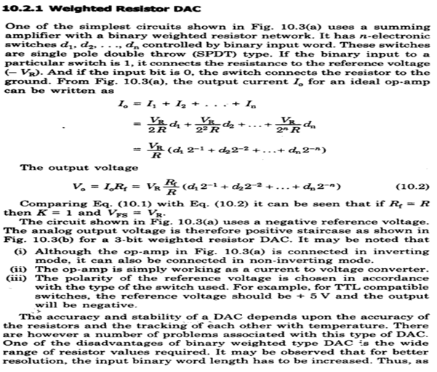

Slide 25
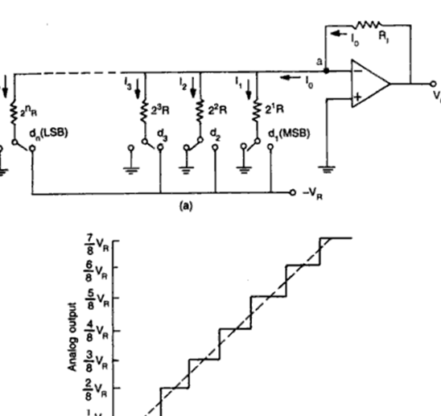
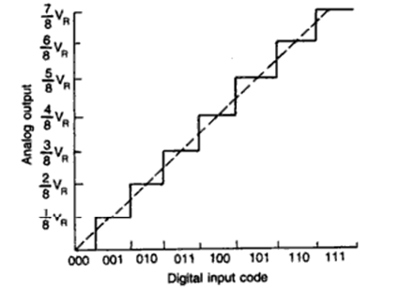

Slide 26
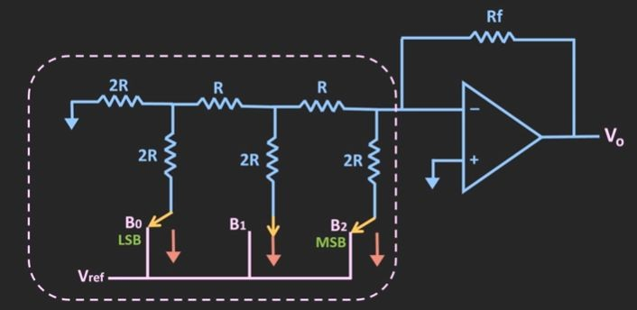
R-2R Ladder-Digital to Analog Converter
R-2R Ladder DAC produces an analog output, which is almost equal to the digital (binary) input by using a R-2R ladder network.
The R-2R resistive ladder network uses just two resistor values, one which is the base value “R” and the other which has twice the value, “2R”

Slide 27
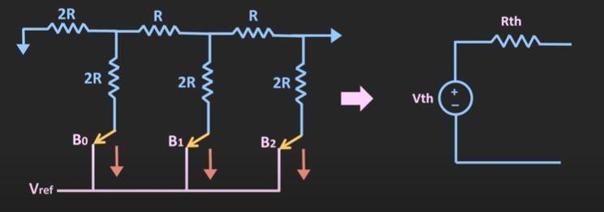
To find Output Voltage
To ﬁnd the overall output voltage, Superposition theorem is used by considering any one source is acting at a time.

Slide 28
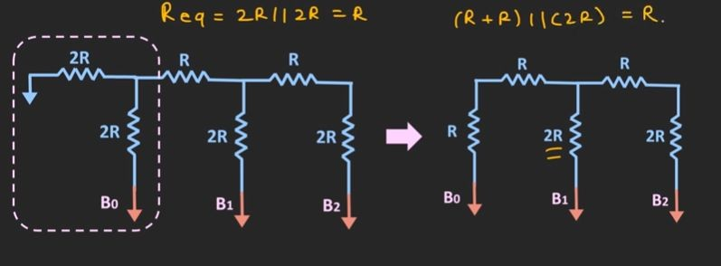
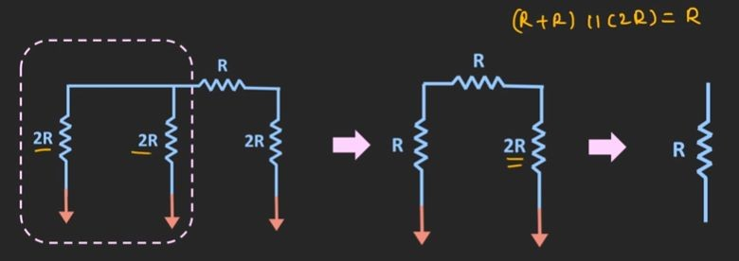

Slide 29
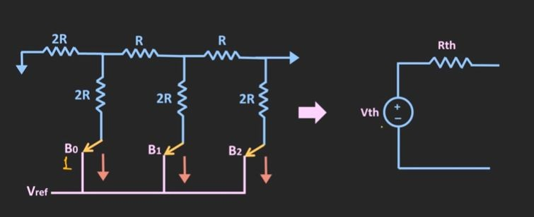
To find Output Voltage

Slide 30

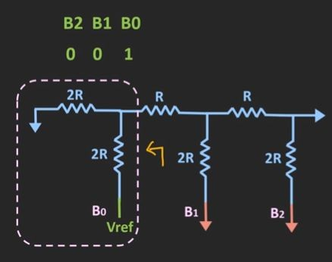
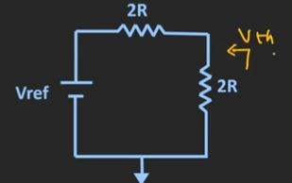

Case :1

Slide 31
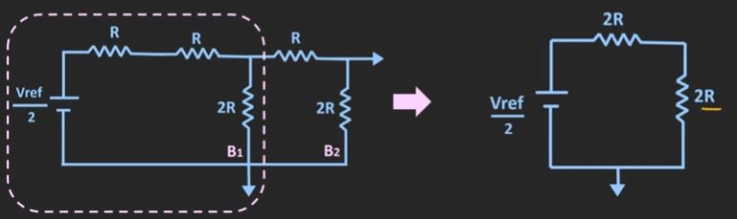
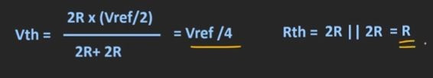

Slide 32
